Slide 1

Padmabhooshan Vasantdada Patil Institute
Of Technology , Bavdhan pune-21
Presentation
on
Internship
Internship Title / Domain: Full Stack Java Student Name:- Prerana Merukar
Roll No:- 66
Class: T.E. computer ,Div: A
Company / Organization: Infosys (Springboard)
Academic Year: 2025–26

Slide 2
Introduction
This internship focuses on the development of a full-stack Java web application.
The project, Crypto tracker pro, is designed to help users manage cryptocurrency portfolios across multiple exchanges.
It provides real-time price tracking, profit & loss analysis, and scam risk detection.
Internship Duration: 01/12/2025 – 01/02/2026

Slide 3
Company / Organization Profile
Organization Name: Infosys (Springboard)
Location: India (Online)
Type: Educational & Skill Development Platform
Services Offered: Industry-ready training, internships, and hands-on projects

Slide 4
Internship Overview
Role / Designation: Software Development Intern
Department / Team: Full Stack Java Development
Mentor / Supervisor: Amit Chaman
Working Mode: Online

Slide 5
Tools & Technologies Used
Programming Languages: Java, JavaScript
Frontend: React.js, Tailwind CSS
Backend: Spring Boot
Database: MySQL
APIs: CoinGecko, Binance, Etherscan, CryptoScamDB

Slide 6
Problem Statement
Cryptocurrency investors use multiple exchanges and wallets, making portfolio tracking complex.
Manual tracking of assets, profits, and losses is time-consuming and error-prone.
There is a lack of integrated platforms that provide real-time portfolio analysis with scam and risk detection.
Investors often face losses due to fraudulent or high-risk tokens without early warnings.

Slide 7
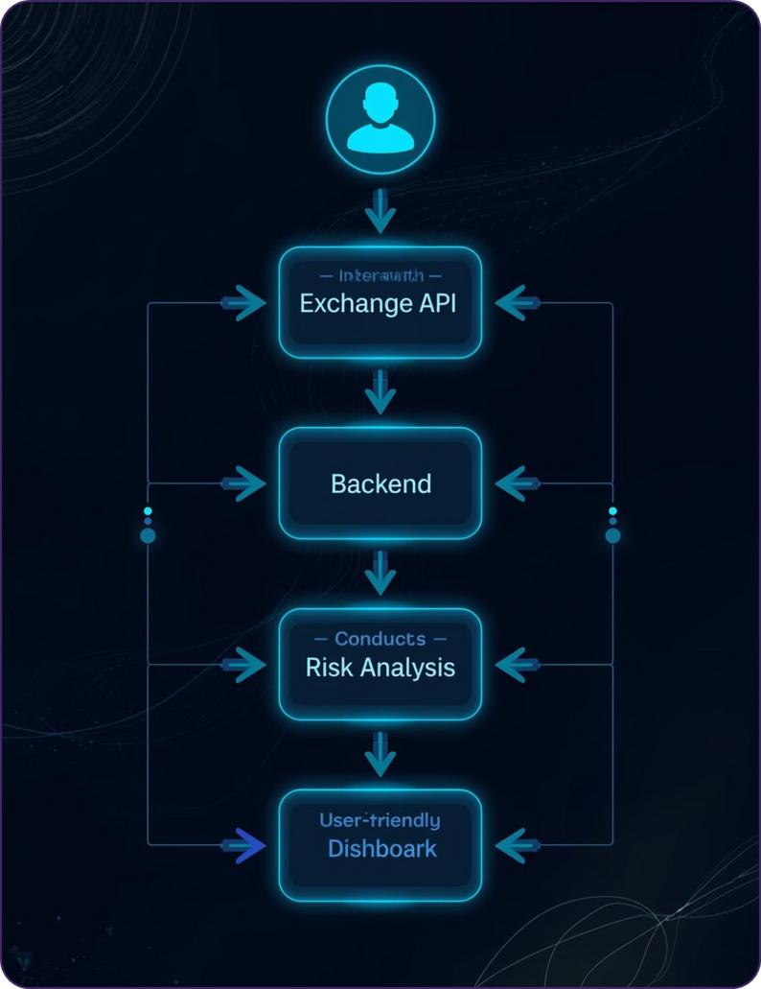
Methodology / Workflow

Slide 8
Work Performed
Milestone 1: Weeks 1–2 – Auth & Connections
Week 1: Auth scaffold, Users/Exchanges/ApiKeys schema
Week 2: Add exchange connectors (Binance first), key encryption at rest
Expected Output:
User can connect an exchange with stored credentials securely.
Milestone 2: Weeks 3–4 – Portfolio & Trades
Week 3: Fetch balances → Holdings; manual add/edit
Week 4: Sync recent trades → Trades; compute cost basis
Expected Output:
Accurate holdings + trade history in dashboards.

Slide 9
Results / Outcomes
Centralized crypto portfolio management system
Real-time price tracking and historical analysis
Early detection of risky and scam tokens
Improved decision-making for crypto investors

Slide 10
Learning Outcomes
Gained hands-on experience in full-stack development
Learned secure authentication using JWT
Improved API integration and database design skills
Enhanced problem-solving and teamwork skills

Slide 11
Challenges Faced
Handling multiple external APIs reliably
Managing real-time data synchronization
Ensuring secure storage of sensitive data
Solution: Modular design and secure encryption techniques

Slide 12
Future Scope
Support for more crypto exchanges
Advanced AI-based risk prediction
Mobile application development

Slide 13
Acknowledgement
Internship Mentor:
Faculty Coordinator:
Department & College: Computer Eng PVPIT bavdhan

Slide 14
Conclusion
To conclude, CryptoTrack pro serves as a comprehensive and intelligent solution for modern crypto investors. It effectively simplifies crypto portfolio management by consolidating assets from multiple exchanges into a single, user-friendly dashboard. By integrating real-time price tracking, profit and loss analysis, and tax-ready reports, the platform enables users to gain clear and accurate financial insights.

Slide 15
Thank You

